Slide 1
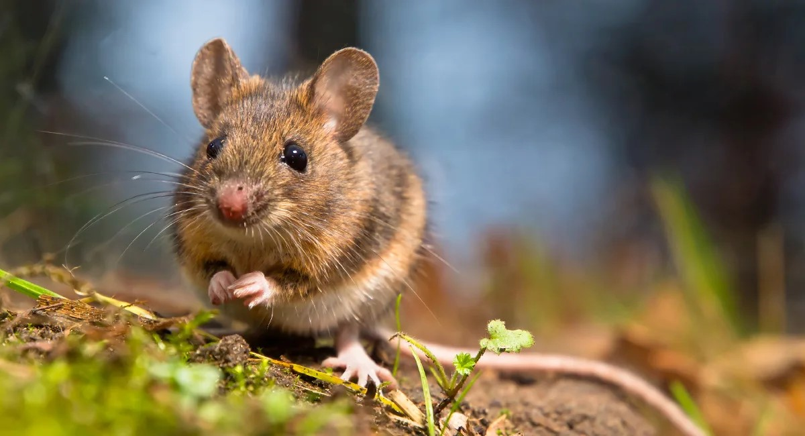

Do Mice Matter? The Impact of Mice on a New Zealand Ecosanctuary
Vanessa Cave
vanessa@vsni.co.uk
November 2025
Biometrics in the Bush Capital
Notes:
Thank you very much.
I’ve been very fortunate to have been involved in a couple of conservation research projects aimed at helping protect New Zealand’s native fauna and flora.
And today I want to talk about one particularly stubborn problem: mice — and the impact they may be having on our conservation efforts.

Slide 2
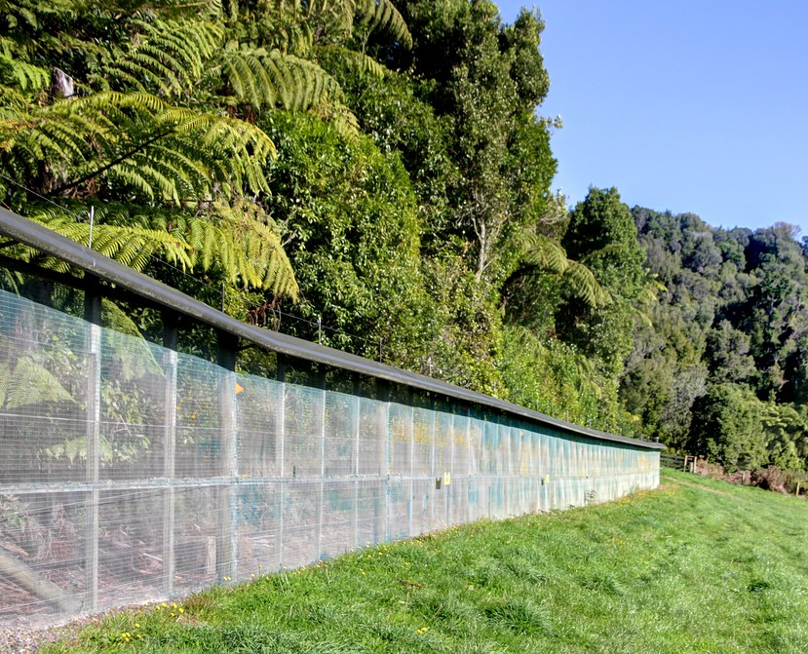
Fenced Ecosanctuaries
The introduction of exotic mammals to NZ has devastated the native ecosystem
Mammal-resistant fences have enabled the eradication of exotic mammals from ecosanctuaries in New Zealand
Fenced sanctuaries aim to protect and restore the native ecosystem
However… preventing the re-invasion of mice has proven challenging!
Mice: good climbers
can squeeze through tiny gaps
Notes:
The introduction of exotic mammals to New Zealand, such as rats, possums, ferrets and mice, has had an absolutely devastating impact on the native ecosystem.
To help protect native plants and animals, and ultimately restore these ecosystems, fenced ecosanctuaries have been created in various pockets of New Zealand.
These ecosanctuaries are enclosed by mammal-resistant fences, like the one shown here. They consist of fine mesh with a metal hood at the top, and below ground a mesh skirt or concrete barrier to prevent animals digging underneath.
Now, the idea is simple: if you remove exotic mammals and plants from inside the ecosanctuary, and keep them out, then the native ecosystem has a real chance of recovery.
However, mice are proving to be quite problematic. Keeping them out is very challenging. Mice are surprisingly good climbers, and for example, can use overhanging foliage to breach the fence. Moreover, they can also squeeze through extremely small holes. Unfortunately even fences with very fine mesh can have tiny weaknesses, particularly around gates and posts that mice are good at exploiting.
Consequently, these pesky mice have ended up being the only exotic mammal left inside in most fenced ecosanctuaries in New Zealand.

Slide 3
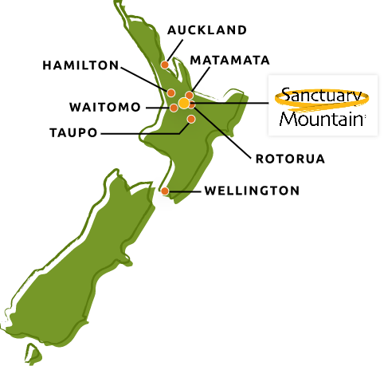
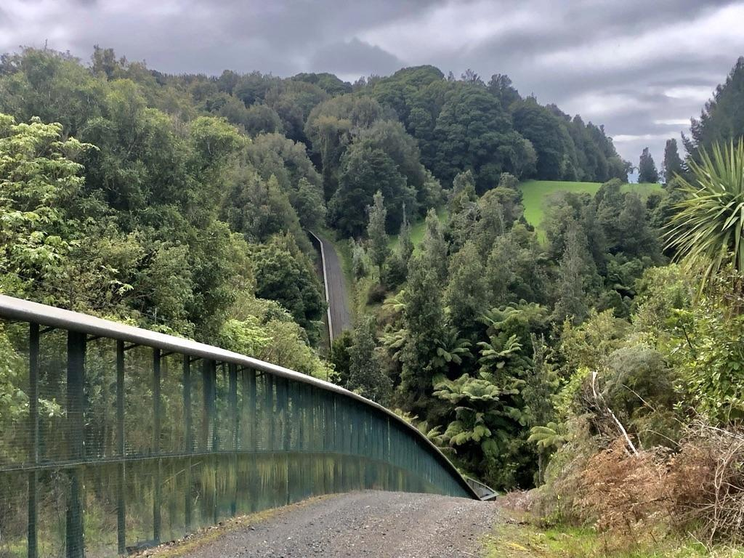

Sanctuary Mountain Maungatautari
New Zealand's largest fenced ecosanctuary (3,400 ha)
Contains areas of ancient forest
Home to endangered animal species
Notes:
One such eco-sanctuary is Sanctuary Mountain Maungatautari, located in the North Island of New Zealand.
It is the country’s largest fenced ecosanctuary, protecting ecologically significant areas of ancient forest and providing a refuge for some of New Zealand’s most endangered animal species.
However, despite dedicated efforts, and lots of investment, the sanctuary is not mouse-free.

Slide 4
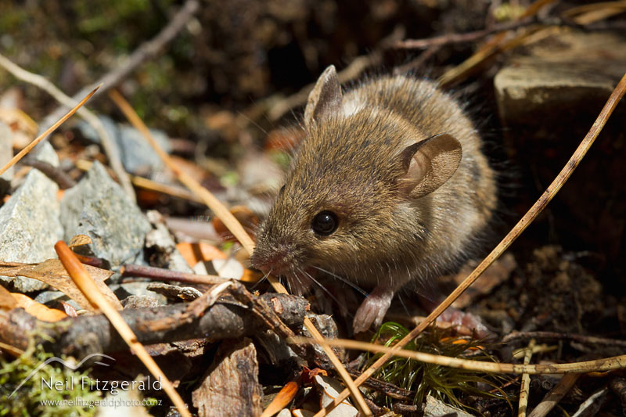
The Mouse Problem
Mice eat native animals and plants
Mice compete directly with native species for food
With limited competition and/or predators, they can become very abundant
Mice are present in fenced ecosanctuaries where all other exotic mammals have been successfully eradicated
What impact are mice having on the native biodiversity in fenced ecosanctuaries?
Notes:
The problem with mice is that they eat a wide range of native animals and plants, including rare and endangered species.
They also compete directly with native species—especially small invertebrates, lizards and some birds—for food resources.
Furthermore, we know that with limited competition for resources and a low risk of predation, their population numbers can explode.
Unfortunately, mice have proven extremely difficult to keep out of fenced ecosanctuaries, so they are often present even when all other exotic mammals have been successfully eradicated.
This raises serious concerns regarding the impact mice are having on the native biodiversity in fenced ecosanctuaries, such as Sanctuary Mountain Maungatautari, in which by virtue of being the only exotic mammal present, they are essentially devoid of predators and face less competition for resources.

Slide 5
The Study
Conducted by Manaaki Whenua – Landcare Research Group at Sanctuary Mountain Maungatautari
Two fenced blocks (IH and IL) within the sanctuary
Cross-over trial
HIGH MICE NUMBERS
LOW MICE NUMBERS
Block IH
Mice Management Protocols Switched after 2 Years
LOW MICE NUMBERS
HIGH MICE NUMBERS
Block IL
Notes:
Thus, Scientists at Manaaki Whenua – Landcare Research group have been studying the impacts of mice on biodiversity at Sanctuary Mountain Maungatautari.
Two independently fenced blocks within the sanctuary were managed to achieve high mouse numbers within one block, referred to as block IH – for initially high, and undetectable mouse numbers within the other block, referred to as block IL – for initially low.
After 2 years, the mice management protocols were switched, with mice eradicated from block IH and their numbers allowed to increase in block IL.

Slide 6
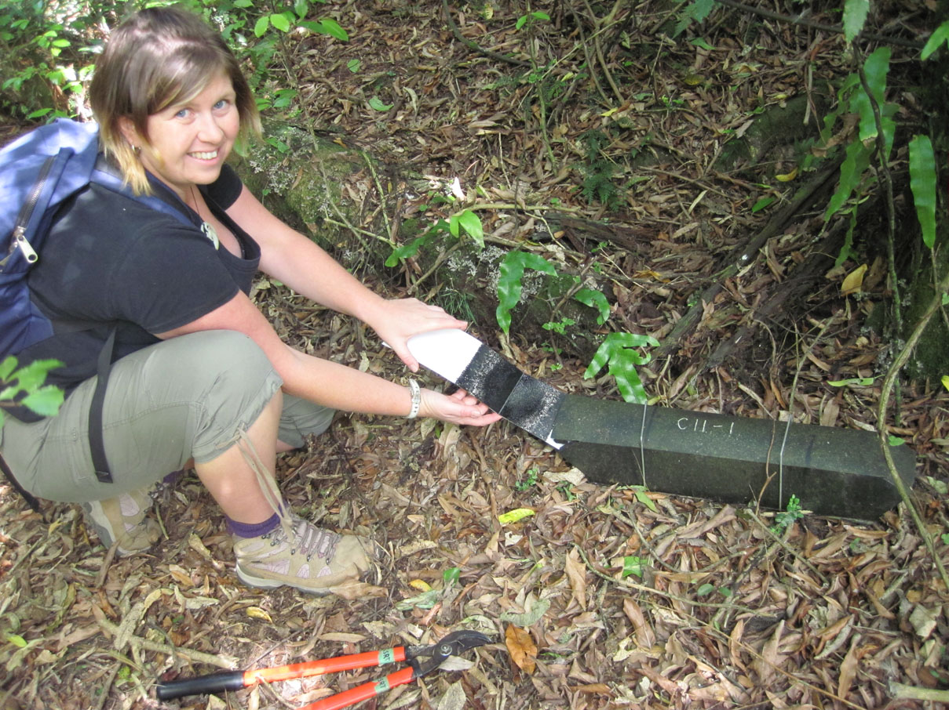
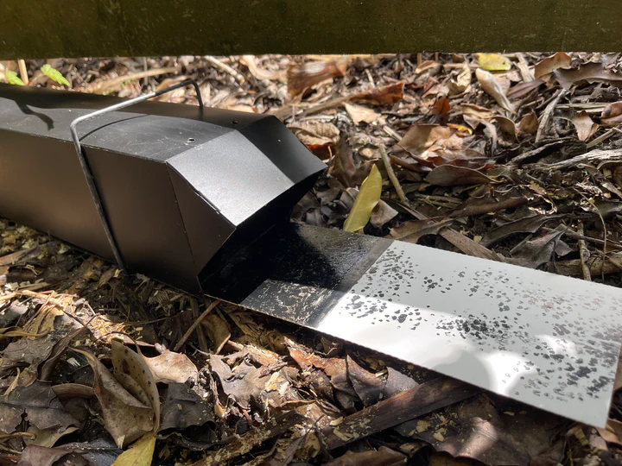
Mouse Eradication Protocol
Initial eradication phase
Aerial poison drops
Maintenance phase
Tracking tunnels (inspected weekly) to detect presence of mice
If detected, intensive trapping and poisoning effort in the surrounding area
Very intensive and expensive – not sustainable long-term
Notes:
To achieve very low mice numbers, an intensive and expensive mouse eradication protocol was used.
This protocol began with an initial eradication phase using aerial poison drops.
It then moved on to a maintenance phase where tracking tunnels, approximately 1 per hectare, were checked weekly for evidence of mice. If a mouse was detected, an intensive trapping and poisoning effort was undertaken in the surrounding area, until there was no more evidence of mice activity.
High mice numbers were simply achieved by stopping all eradication and control efforts. And its rather disheartening how successful just stopping control resulted in high mouse numbers.

Slide 7
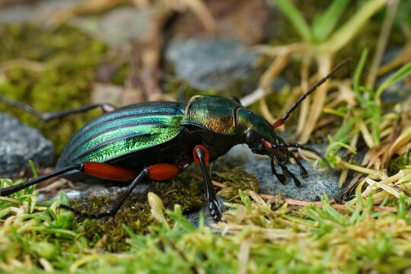
Data Collected
 | Sampling Method | Number per Block | Frequency
Ground-dwelling invertebrates | Pitfall trap | 20 | 4 times per year
Leaf litter invertebrates | Quadrant (counting) | 32 | Annually
Land snails | Quadrant (Tullgren funnel) | 32 | Annually
Wētā | Tracking tunnel | 24 - 36 | 4 times per year
Earthworms | Quadrant (searching) | 20 | Twice
Seedlings | Quadrant (counting) | 36 | Thrice
Fungi | Quadrant (counting) | 36 | Once
Today’s focus
Paper: Watts et al. (2022) in New Zealand Journal of Ecology
Notes:
Over the course of the study, extensive data were collected on the biodiversity of plants and invertebrates.
Today, however, I’ll focus on the ground-dwelling invertebrate data.
These are invertebrates which live primarily on or in the soil, leaf litter, or forest floor, and include creatures such as beetles, spiders, centipedes, and slugs.

Slide 8
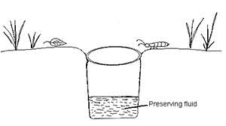
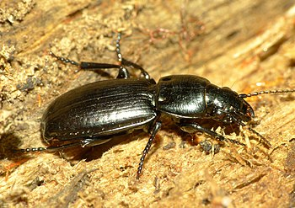
Sampling Ground-dwelling Invertebrates
Sampled using pitfall traps placed along transect lines
Transects randomly located within each block
Traps set for 1 month at a time
Sampled 4 months per year: November, December, February, and April
A total of 42,639 invertebrates were caught
All were sorted (at least) to the Order level
Rich data set!
Key variable of interest: Total number caught per trap
Notes:
Now, the ground-dwelling invertebrates were sampled using pitfall traps placed along transect lines, randomly located within each study block.
Pitfall traps are very simple devices – just small containers sunk flush with the ground and partially filled with preserving liquid—that capture invertebrates as they move across the ground.
The pitfall traps were set for one month at a time, always in approximately the same location, with data collected during four months each year: November, December, February, and April. Unfortunately, financial constraints prevented sampling during every month of the year.
Over the course of the study, more than 42,000 invertebrates were caught and classified. So, this is a very rich dataset, offering plenty of scope for interesting statistical analyses.
In this talk, I’m going to focus on the key variable of interest: total number of ground-dwelling invertebrates caught per pitfall trap, and this is a proxy for their abundance.

Slide 9
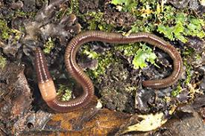

Statistical Analysis
Aim: Compare the temporal trends between the two study blocks
Fitted a linear mixed model with smoothing splines over time
Fixed: Block + Time + Block.Time
Random: Month + Transect + Transect.Time + Trap + Trap.Time
Spline(Time) + Block. Spline(Time) + Transect. Spline(Time) + Trap. Spline(Time)
i.e., Trends over Time
Correlated
 | Constant | Linear | Spline
Overall | Fixed | Fixed | Random
Block | Fixed | Fixed | Random
Transect | Random | Random | Random
Trap | Random | Random | Random
Month | Random
Notes:
The aim of the statistical analysis was to compare the temporal trends in invertebrate abundance between the two study blocks.
To do this, we fitted a linear mixed model with smoothing splines over time to model the temporal trends for each block and the covariance structure of the longitudinal data.
The fixed model comprised of a factor for block, a covariate for time, and the time by block interaction.
Random effects for month, transect, transect by time, and correlated random intercepts and slopes over time for the pitfall traps, were also included,
And finally, the model included an overall spline over time, and individual time splines for the blocks, transects and pittraps.

Slide 10
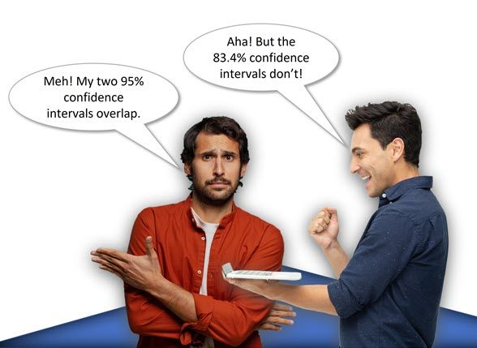
83% Confidence Intervals
Differences in the temporal trends examined using 83% C.I.s
Why not 95%?
For two independent Normally distributed samples, of equal size and common variance …
just touching 83% C.I.s corresponds to a two-tailed t-test with a p-value of ≈ 0.05
whereas
just touching 95% C.I.s corresponds to a two-tailed t-test with a p-value of ≈ 0.005
Notes:
Differences in temporal trends between the two study blocks were examined by plotting 83% confidence intervals around the predicted means.
We used 83% intervals rather than the more common 95% intervals because just-touching 83% confidence intervals correspond approximately to a p-value of 0.05.
In contrast, just-touching 95% intervals correspond to a much smaller p-value, and we did not want to be that conservative.
I find 83% confidence intervals a very convenient way to help visualize the differences between the estimated trends of two groups.

Slide 11
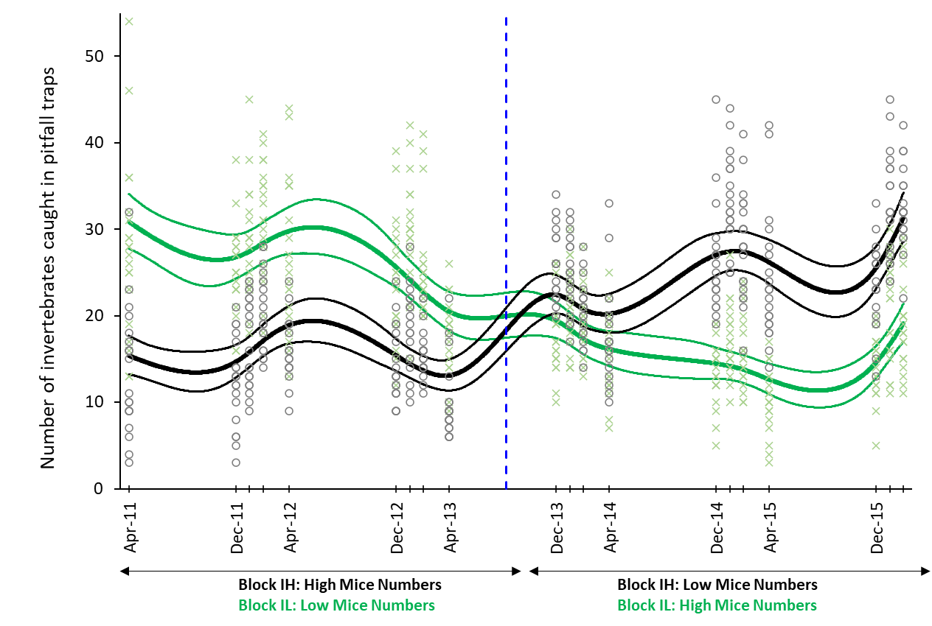
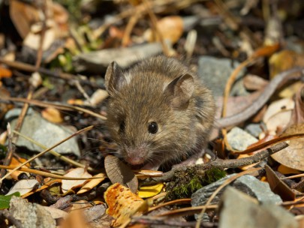
The Results
Treatment Switch
Notes:
The results…
In this plot, the estimated means and 83% confidence intervals for the two blocks are shown as lines:
block IH, which initially had high mouse numbers, is in black, and
block IL, which initially had low mouse numbers, is in green.
The raw data are plotted as points.
Midway through the study, the treatments were reversed, as indicated by the blue vertical line, with mice eradicated from block IH and allowed to increase in block IL.
What’s striking is that the mean number of ground-dwelling invertebrates caught in pitfall traps is lower in the block under the management protocol that results in high mouse numbers.
That is, initially abundance was lower for block IH in black, and after the treatment switch it was lower for block IL in green.
This finding supports the concern of conservationists that, left unchecked, mice can cause substantial damage to biodiversity in fenced ecosanctuaries.
Similar conclusions were drawn from the other datasets collected in this study.

Slide 12
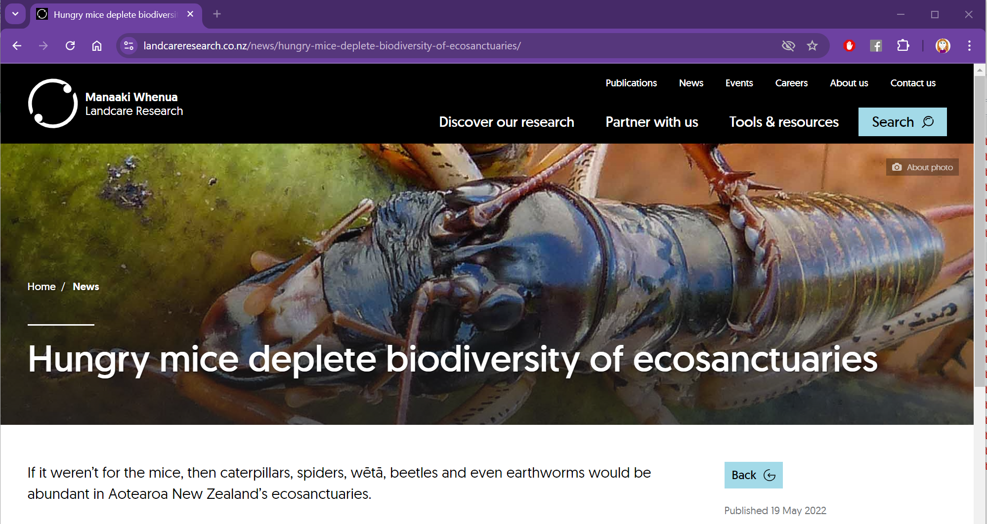
The Implications
Mice may be catastrophic in ecosanctuaries that focus on the recovery of invertebrates (or their predators)
Need more cost-effective methods for controlling mice in fenced ecosanctuaries
Notes:
Therefore, while removing ALL exotic mammals from ecosanctuaries generally boosts biodiversity (which we know from other research), allowing mice to persist can be catastrophic for ground-dwelling invertebrates and, by extension, their native predators, such as lizards and birds.
Or as Manaaki Whenua – Landcare Research group noted in their press release: "If it weren’t for the mice, then caterpillars, spiders, wētā, beetles, and even earthworms would be abundant in Aotearoa New Zealand’s ecosanctuaries."
This research underscores the need for more cost-effective methods of controlling mice in New Zealand’s fenced ecosanctuaries.

Slide 13
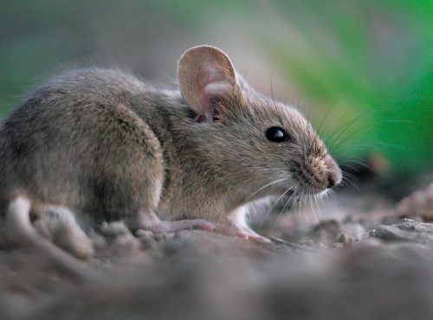
What About Replication?
Two blocks (2 sequences):
Block IH: High mice Low mice
Block IL: Low mice High mice
The trial was very expensive and logistically challenging
Independent replication of the sequences was infeasible
Therefore … the analysis is descriptive
Differences between blocks may reflect the different mice control protocols
However, due to lack of replication, causation cannot be inferred
Notes:
However, we need to be a bit cautious when interpreting these results.
Recall that there were just two blocks: mouse numbers were initially high in one block and low in the other. After two years, the management protocols were switched to achieve the reverse.
Due to the study’s cost and logistical constraints, including the limited availability of suitable blocks in fenced eco-sanctuaries, the experiment was effectively unreplicated.
While the observed differences between blocks over time are consistent with what we might expect from the different mouse control protocols, we cannot—and should not—conclude causation.
Nevertheless, when considered alongside other evidence and existing scientific knowledge, these results reinforce the importance of dealing with mice in ecosanctuaries.

Slide 14
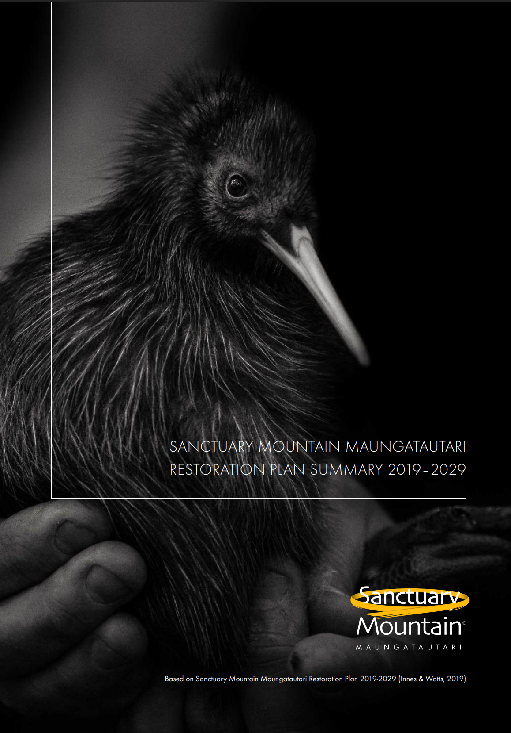
Mouse Control at Maungatautari
Total eradication across the mountain is not currently feasible
Strategy focuses on monitoring and minimizing impacts
Monitoring: Extensive system of tracking tunnels and cameras to detect mouse activity and other pests
Incursion Response Plan: Detected mice are controlled with targeted trapping and baiting
Mouse‑free Refuges: Smaller mouse‑free exclosures to protect sensitive invertebrates and lizards
Notes:
So, what’s the plan to manage mice at Sanctuary Mountain Maungatautari ?
Unfortunately, complete eradication of mice from the ecosanctuary isn’t currently feasible due to cost and practicality
As a result, the current strategy focuses on monitoring mouse populations and minimizing their impacts.
To monitor, there is an extensive network of tracking tunnels and cameras inside the fence to detect mouse activity, as well as other pests.
If mice are detected, a rapid-response Plan is activated, involving targeted trapping and baiting to control the mouse population.
In addition, smaller mouse-free exclosures are maintained within the sanctuary to protect native invertebrates and lizard species that are particularly vulnerable to mice.

Slide 15
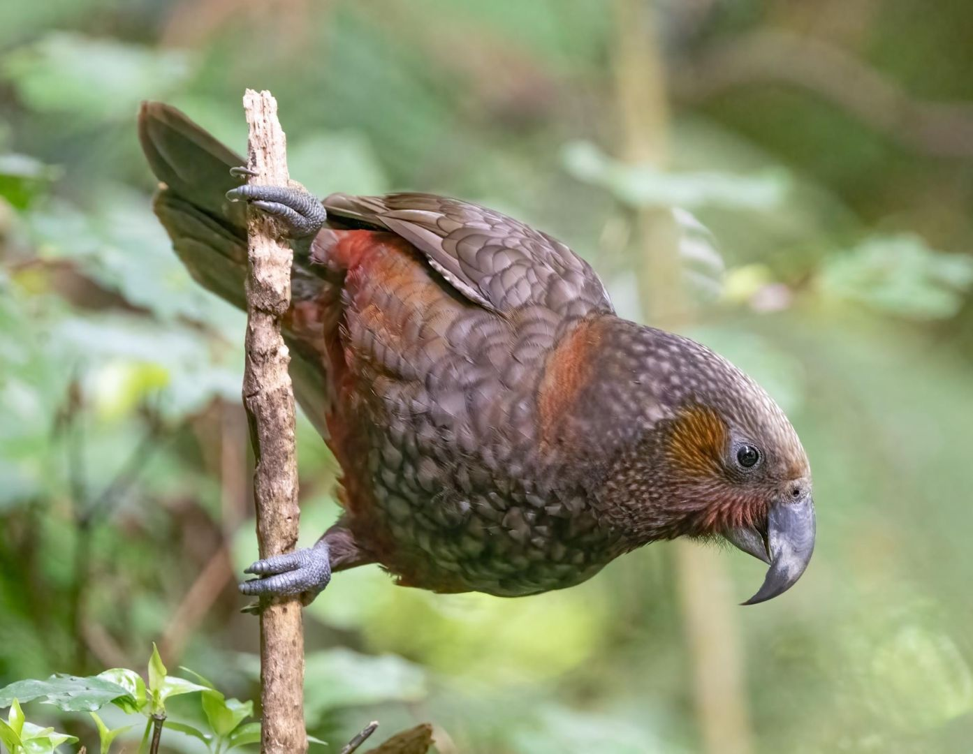
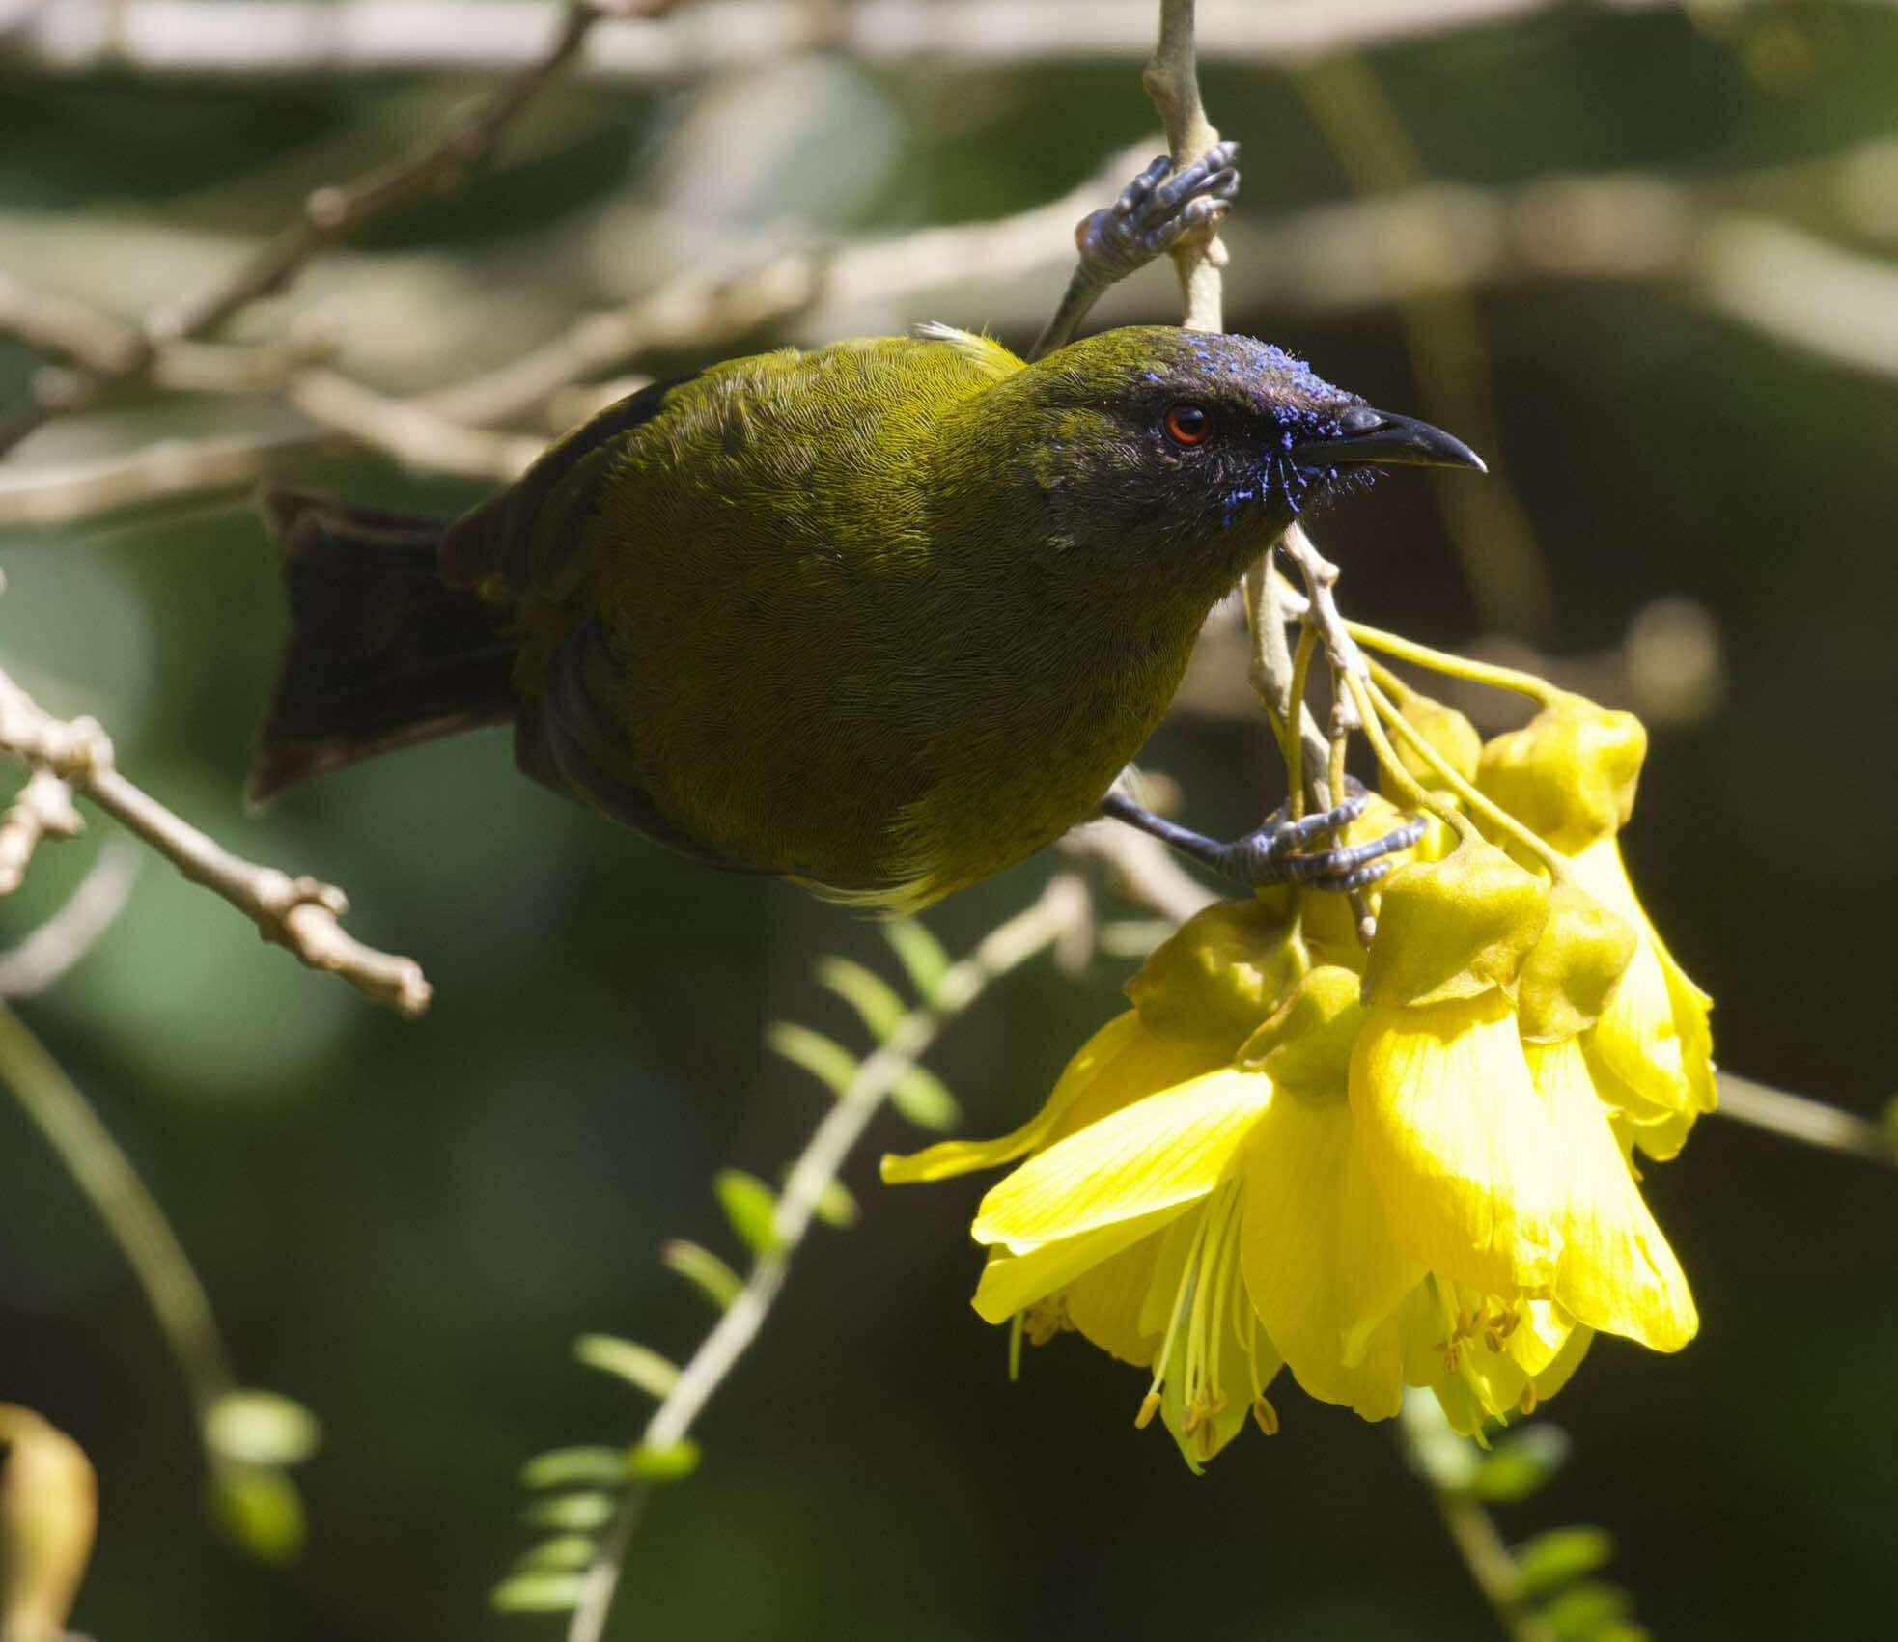
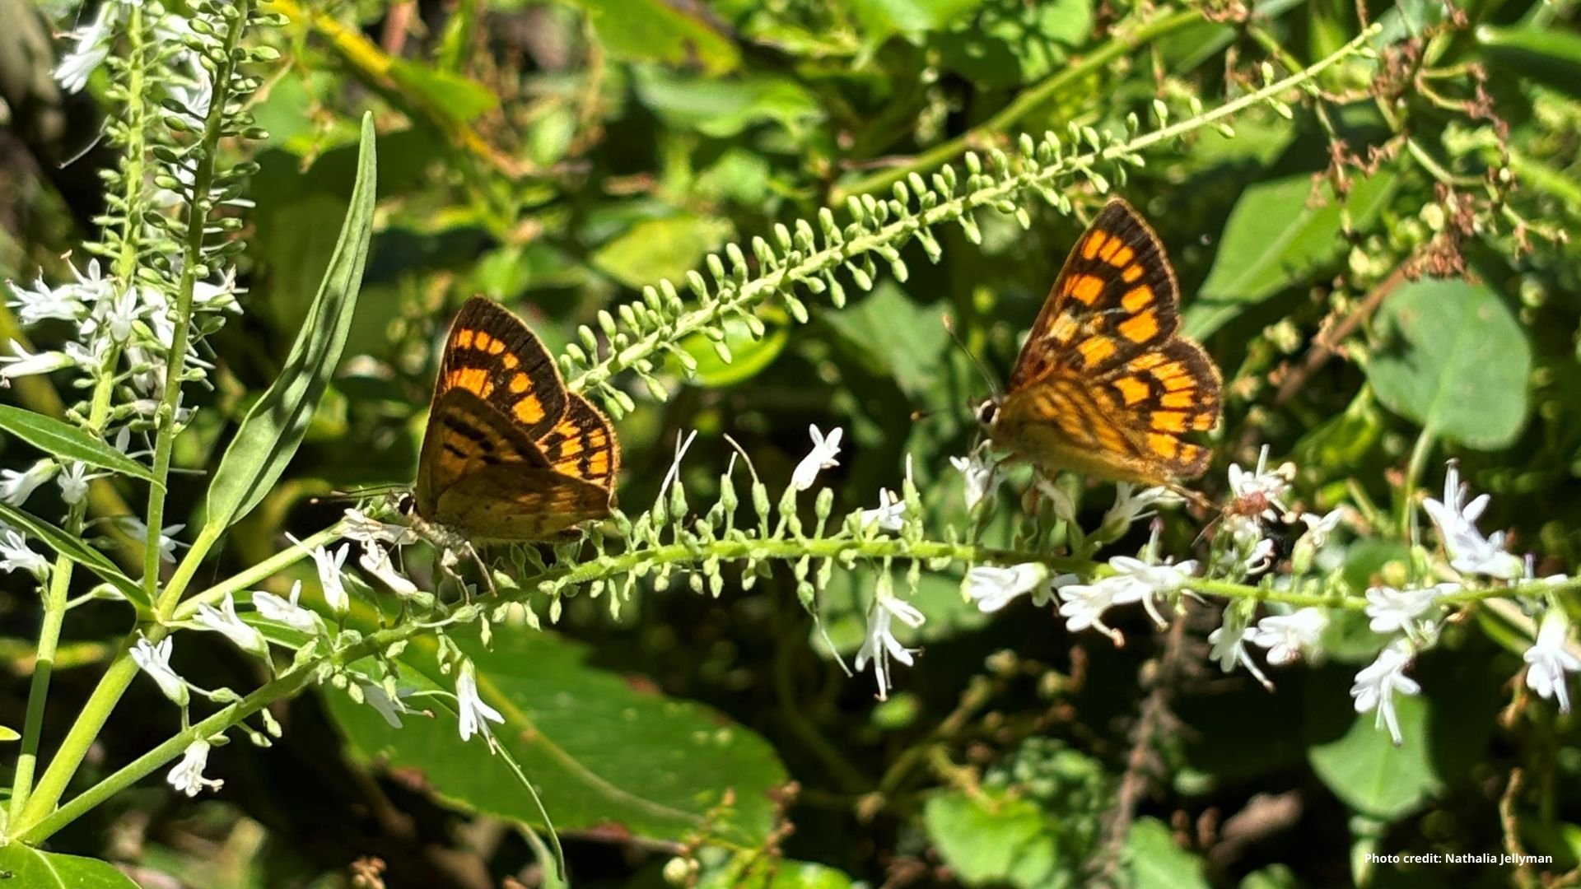
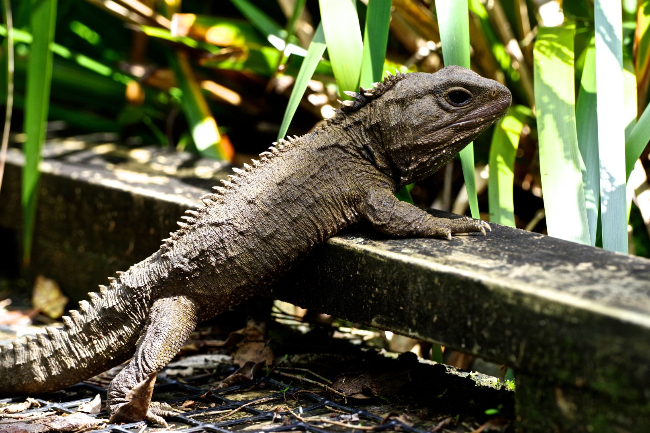
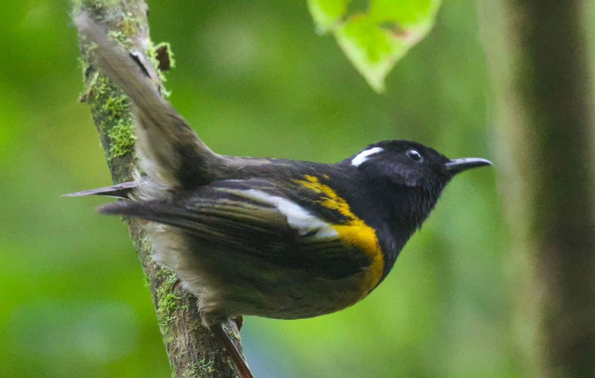
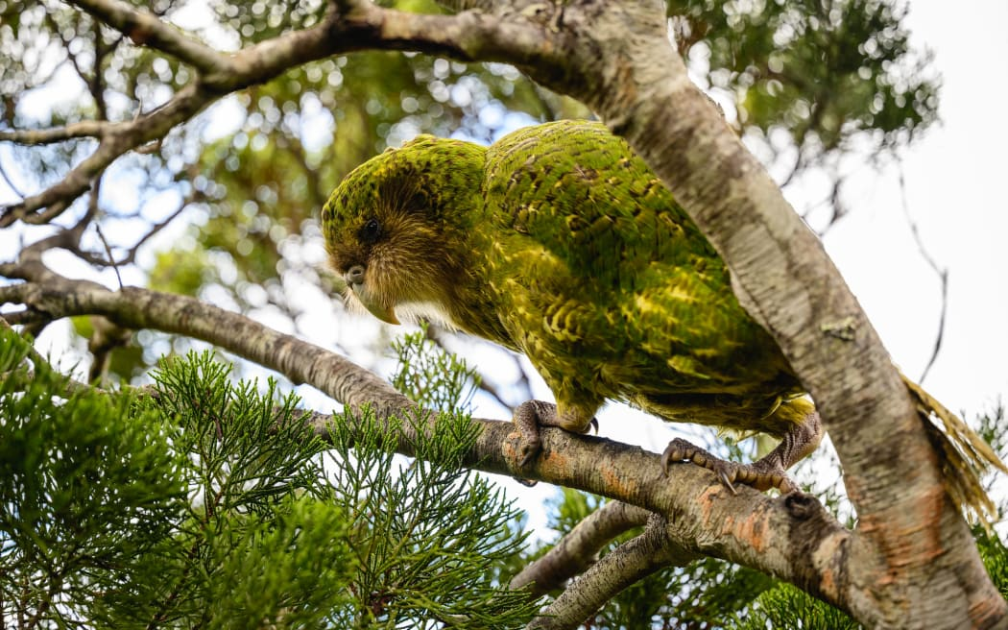
Thank You
Paper
Watts et al. (2022) https://newzealandecology.org/nzje/3472
Notes:
Thank you very much – that’s about all from me.
If you’d like to explore the details of the analysis and results in greater detail, they are available in Watts 2022 published in the NZ Ecology Journal.
I’ll now leave you to enjoy a few photos from Sanctuary Mountain Maungatautari. It’s a very beautiful and special place, home to many of New Zealand's unique and endangered wildlife, including kiwi and tuatara—and not forgetting plenty of amazing, yet often under-appreciated, ground-dwelling invertebrates! It’s well worth a visit if you’re ever in the area.
Thank you!

